Slide 1
Review: The Blimp Program Framework
Atrium Controller
Trajectory Estimator
3 Images
SIngle Blimp
Input Image
Estimate Trajectory Till state t
3 Estimate Trajectory Till state t-1
3 Commands
Single Blimp Estimate Trajectory Till state t-1
Estimate pose/vel at state t
The MAP
The MAP
Command Generator
Trajectory Generator
One desired pose/vel at state t+1
3 Estimate Trajectory Till state t
3 desired pose/vel at state t+1
1 Command
Cost Function Parameter
One Estimate Trajectory at state t

Slide 2
The Blimp Program Framework
Atrium Controller
Trajectory Estimator
Trajectory Generator
Command Generator
Video Stream
Trajectory Estimator
Superpoint
SFM
Create new landmark from Feature
Create new pose by manually set a small change from the previous pose
Create Factor Graph
Optimize
Velocity Generator
Feature
Images
SFM_Superpoint
BlimpTrajectory
Features
AtriumMap
Tracking Info

Slide 3
Questions:
Build gtsam with Python 3
I try to change the two settings in the console table of cmake-gui
- PYTHON_EXECUTABLE
- PYTHON_INCLUDE_DIR
Can not use find definition in Visual Studio?
Is this because of the wrapper?
iSAM
3.1 why can each camera in the VisualISAM2Example see all the landmarks?
3.2 If all landmarks are different will iSAM merge the same landmarks automatically?
3.3 Any suggestions on creating ground truth landmarks
4. Do we treat mapping as registering three individual maps into one large scale map or do we treat mapping as a large SFM?
5. Do we merge landmarks in the iSAM graph or do keep adding landmarks for each pose?
6. Do we calculate the velocity and angular velocity through the tracking information or do we use the derivative of time to calculate the velocity?
7. How to use the tracking information?

Slide 4
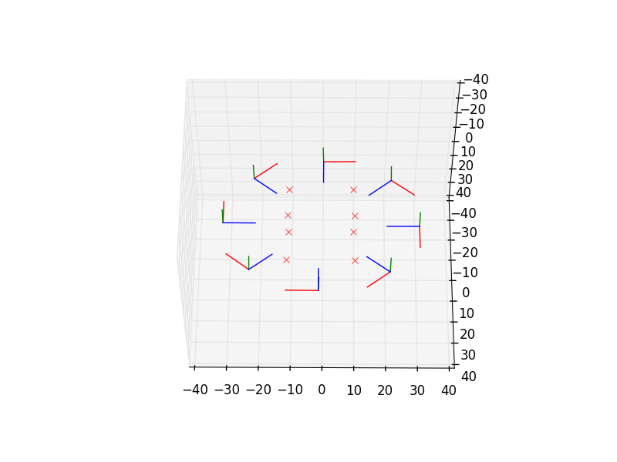
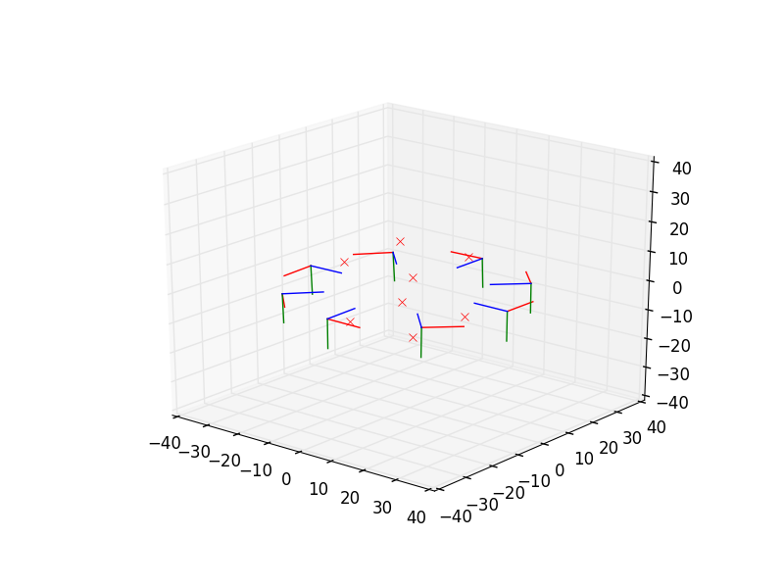
VisualISAM2Example

